Slide 1

AI-Powered Multi-Modal Detection System By: Team SOD(Straight Outta Data)
Charles Wibonele
Tochukwu Nto Mbah
HaBeeb Ajibola

Slide 2



AGENDA:
BUSINESS PROBLEM
DATA STORAGE
BUSINESS SOLUTION
DATA ENGINEERING
DATA SOURCE
Multi-Model Structure/Eval
DATA ARCHITECTURE
VISUALIZATIONS
DATA QUALITY
Power BI

Slide 3
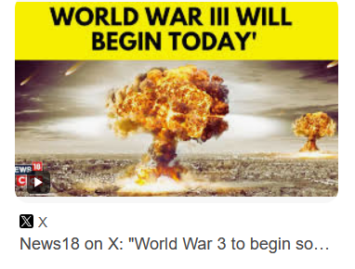
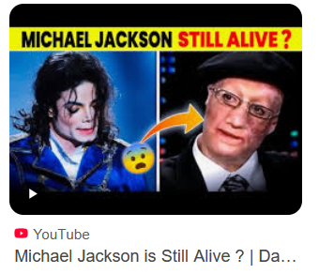
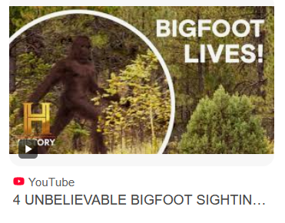
Business Problem
The rise of deepfake media and the spread of AI-generated fake media
Threat to journalism, public trust, and media integrity
Need for reliable automated detection systems

Slide 4
Build a scalable, explainable, and multimodal detection system that works across platforms.
We are developing a hybrid deepfake detection system.
Combines visual content (images/videos) and textual data (news articles).
Utilizes:
Vision Transformer (ViT) for image classification.
Efficient-Net and NST50/LSTM for video classification
BERT-based-uncased base model for text classification of fake vs. real news.
Power BI for explainability and visualization.
Gradio UI for interactive demonstration.
Business Solution

Slide 5
Dataset Sourcing/Overview( Images)
Dataset Used: DeepFakeNews Dataset (Zenodo)
Link: https://zenodo.org/records/11186584
Size: ~500,000 images split into real vs. AI-generated
Image Sources:
Real: Original Fakeddit posts
Fake: Generated using Stable Diffusion, Dreamlike, and GLIDE
Metadata: Provided in CSV format (title, label, image path)
GitHub Used: https://github.com/enricollen/DeepfakeDetection

Slide 6
Dataset Overview/Sourcing - 2 (Video)
Dataset Used: FaceForensics++ (downloaded via script)
Link: https://github.com/ondyari/FaceForensics/blob/maste
Size of dataset : the dataset consists of 1000 original video sequences
Video sources:
Real: sourced from 977 youtube videos
Fake: Manipulated using DeepFakes, FaceSwap, Face2Face, NeuralTextures
Metadata:
Metadata includes columns like: video filename, label, fps, frame count, and duration
Stored in CSV format and uploaded to S3 for querying with AWS Athena

Slide 7
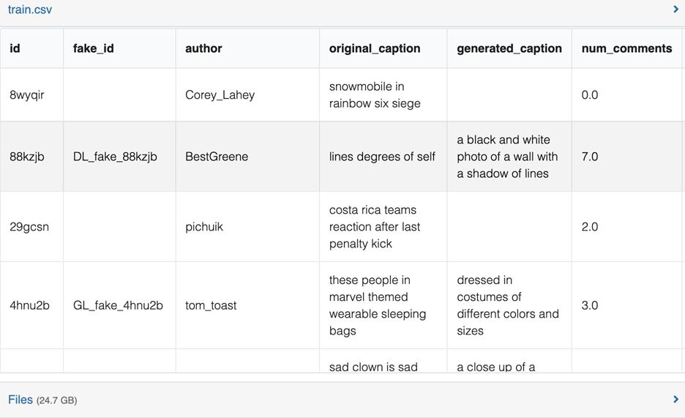
Types:
Streaming: Real-time surveillance, social feeds (not used here)
Non-Streaming: This project is primarily non-streaming. Our dataset from Zenodo is static, downloadable.
Structured vs Unstructured:
Structured: Our CSV files (train.csv, test.csv, validation.csv)
Unstructured: Images in .zip format — no direct schema
Formats Used:
CSV: Metadata
JPG: Images
Data Source Types

Slide 8
Data sourcing strategy
Format: CSV for metadata, ZIP of JPEG images
Connectivity : Our dataset is uploaded to AWS S3 and we used AWS Glue and Athena to automatically detect, catalog, and query structured and unstructured data stored in the cloud.
Schedule: Manual or event-based scheduling
High Availability: We ensured high availability by storing our cleaned datasets in S3 which makes the data available on demand
Change Process: Automatically schedule or trigger AWS glue crawlers to detect schema changes

Slide 9
Completeness
We checked for null values using df.isnull().sum() and cleaned or dropped incomplete records.
We ensured that no row was missing critical fields like fake_id, original_caption, label
Timeliness
Data was pulled and cleaned before training. We ensured that files reflected the most recent structure by checking their last modified timestamps in S3
Validity
Were the values what we expected?
Columns were compared against schema expectations: Example “num_comments” must be numeric, author must be string, fake_id must follow naming convention.
Invalid entries were either corrected, replaced with placeholders, or removed.
Consistency
We ensured labels and data values were standardized across train.csv, test.csv, and validation.csv
Conformity
Did values follow a standard format? For instance:
fps is always a float (like 24.0).
label must be either 'real' or 'fake'.
Image paths and fake IDs expected naming patterns like DL_fake_, SD_fake_
Data Quality Checks

Slide 10
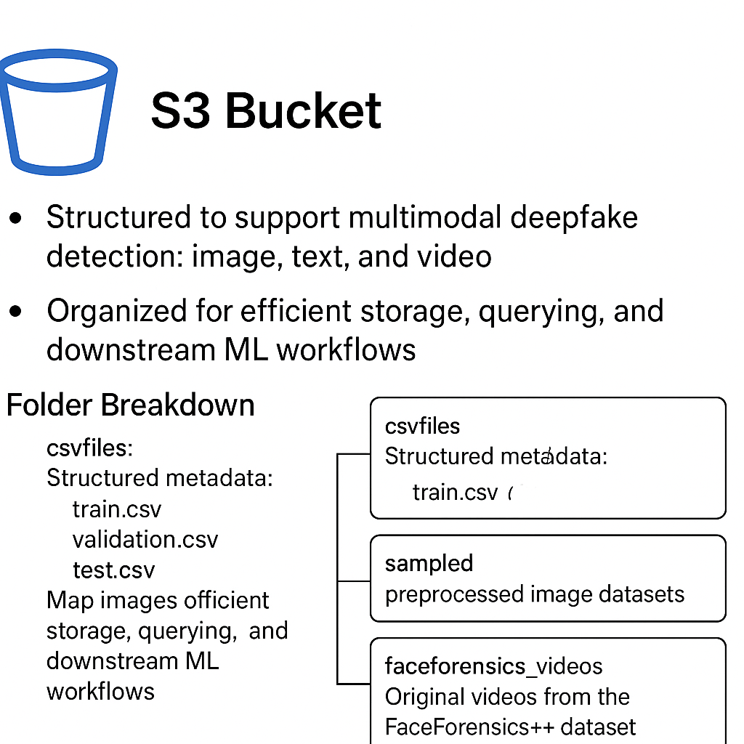
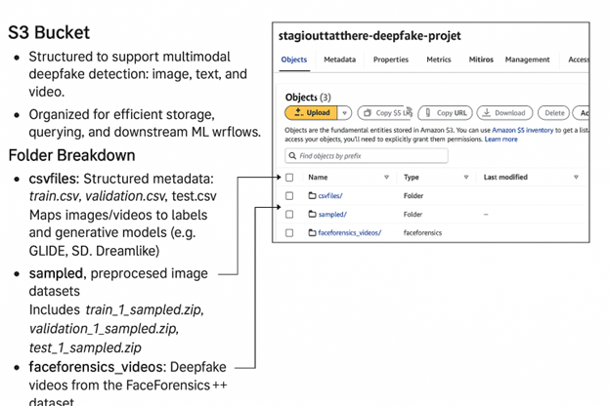
Data Storage

Slide 11
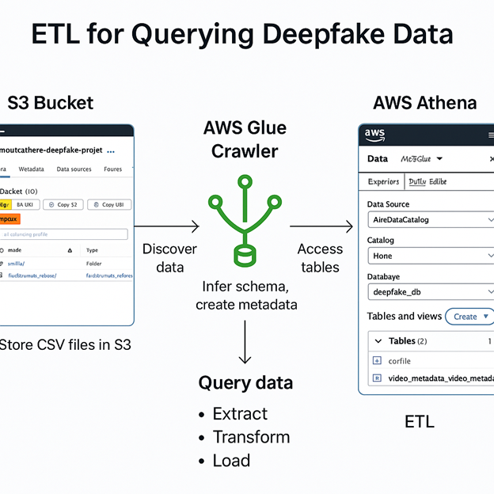
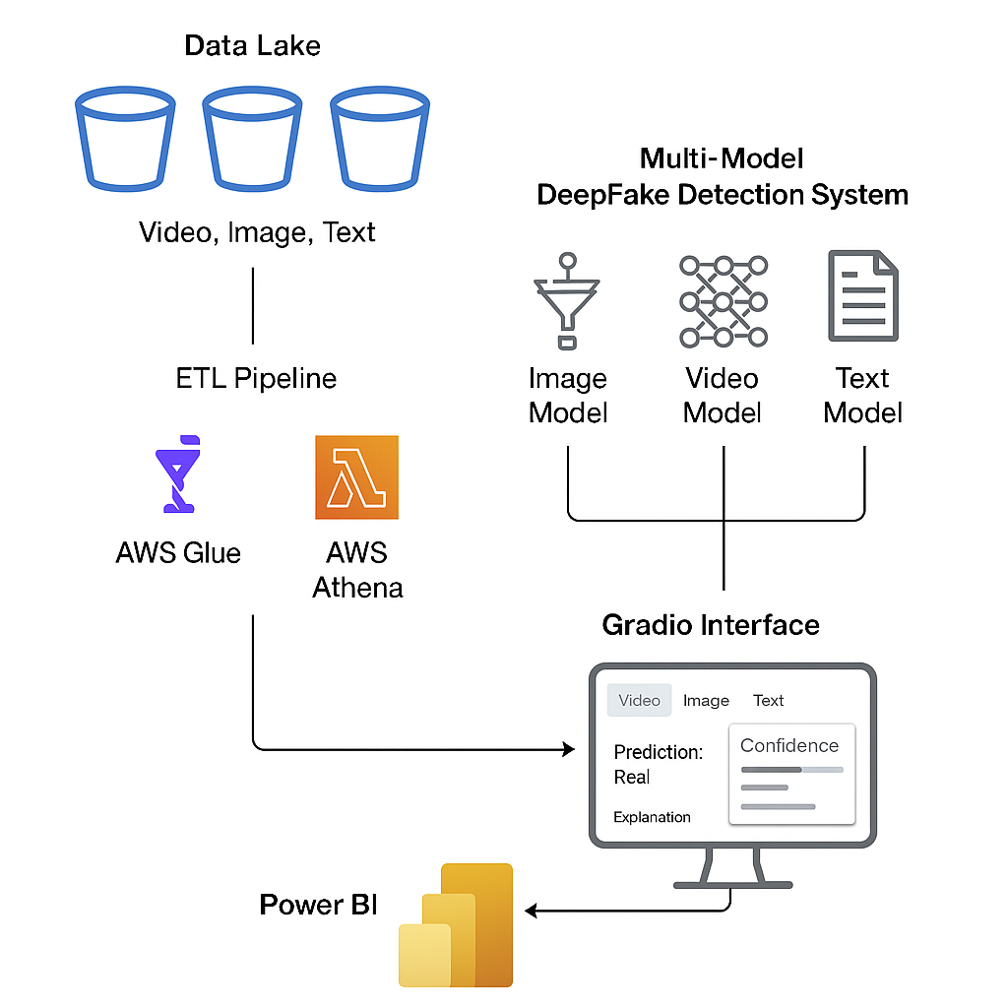
Data Engineering
We extracted our files from AWS S3 bucket, then applied some Transformations on it by utilizing AWS Glue with Data Catalog and Data Crawler, which allows us to create Metadata.
Then we used AWS Athena to make simple queries and view our Data.
For our loading, we will then move to Google Colab, where we will train and evaluated each of our models individually for text, image, and Video.

Slide 12
Data Architecture

Slide 13

Analytics
What We're Working With
What We Aim to Analyze
Using DeepFakeNews dataset1 (509,916 images), enhanced for storage.
Analyzing 254,958 real (pristine) images and Deepfake images (tSD, GLIDE, Dreamlike, deepfake) – structured across training, validation, and test splits.
Incorporating deepfake video files from FaceForensics++ for multimodal learning.
Distribution of real vs. fake content across different splits.
Class label frequency and class imbalance checks.
Correlation between text labels and image content.
Temporal frame-level consistency in deepfake videos.
AI/ML Model Planning
Next Steps
Building binary and multiclass classifiers using:
ViT(for images)
BERT-based-uncased base model (for text)
LSTM / Efficient-Net/ NST-50(for videos)
Model Training & Deployment
Visualization
User Interface
Dashboard & Reports

Slide 14
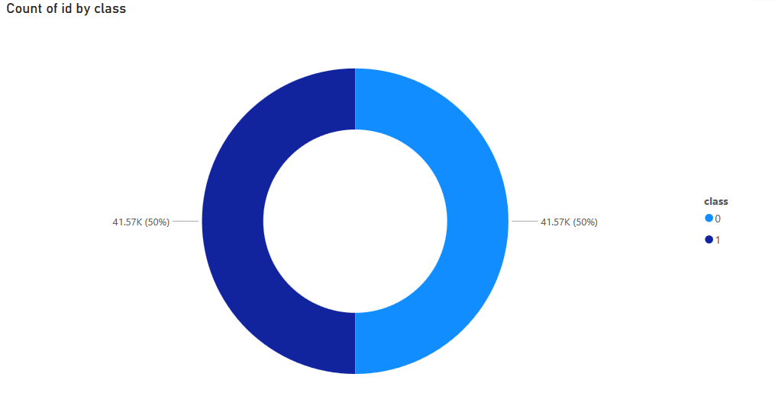
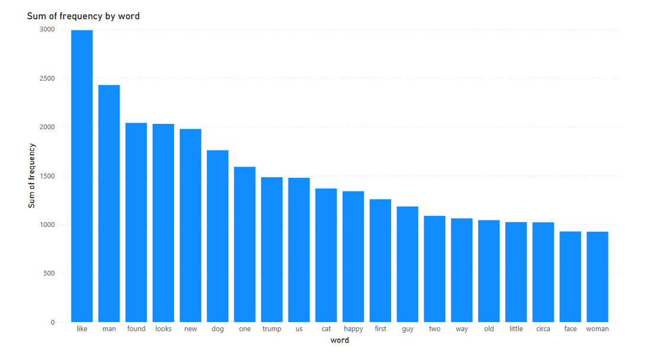
EDA

Slide 15
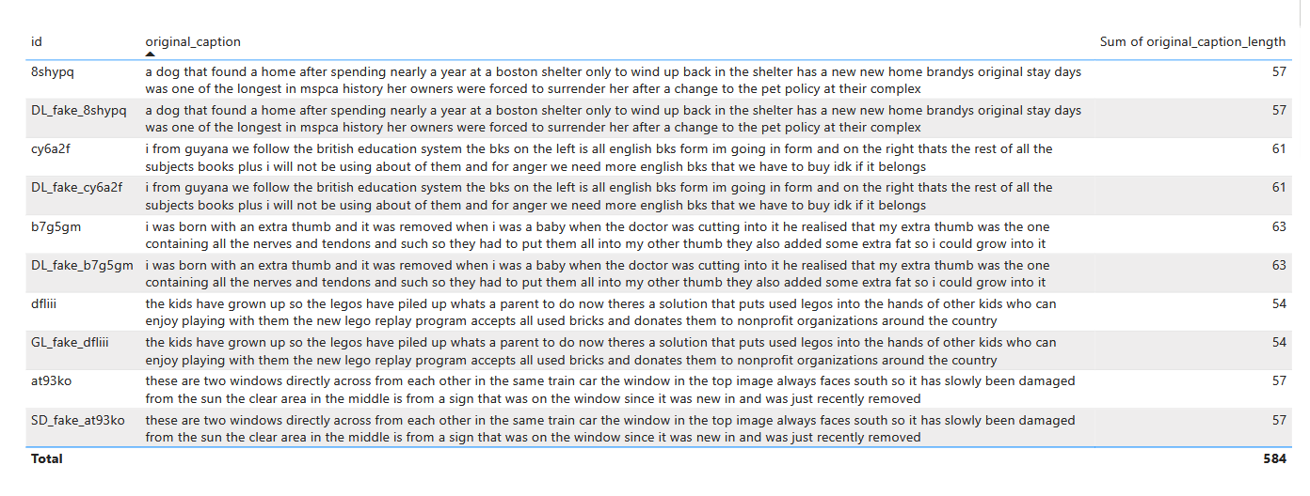
EDA

Slide 16
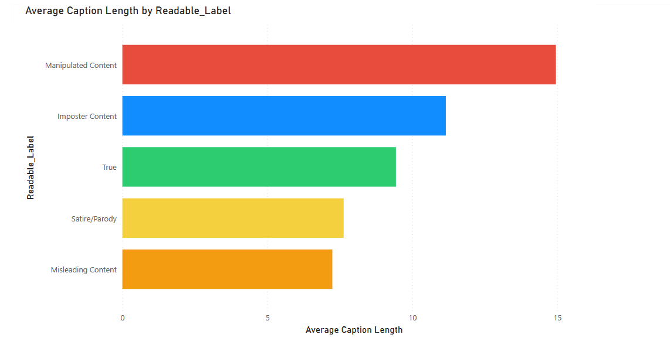
EDA

Slide 17
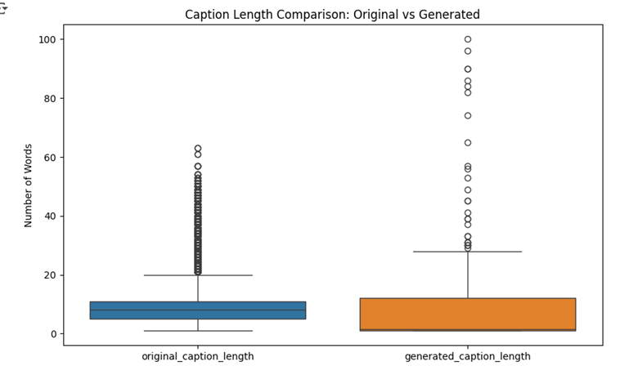
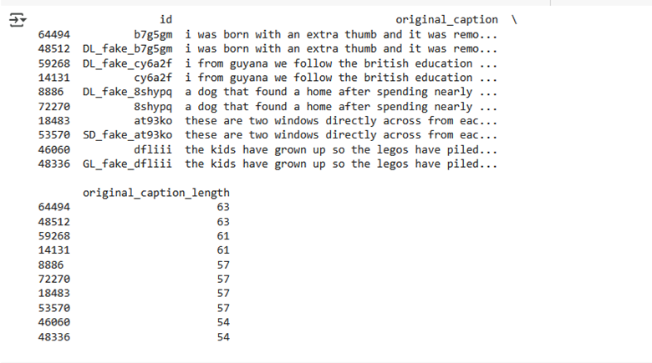
EDA

Slide 18
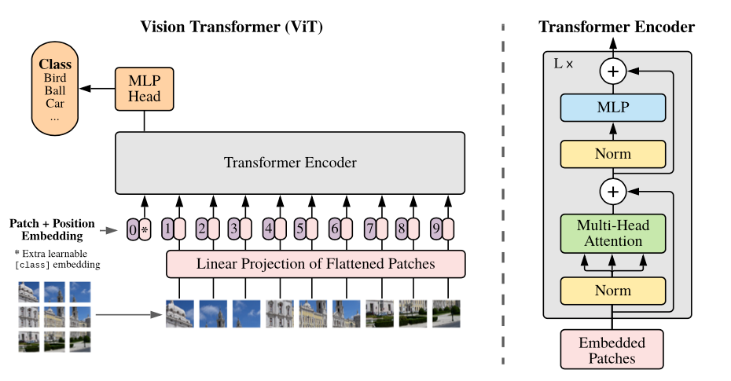
Image Model
Model Architecture:
Used a Vision Transformer (ViT) model architecture.
ViT extracts image patch embeddings and processes them like sequences.
Fine-tuned on deepfake images to classify between real and fake.
Hyperparameters & Training Setup:
Optimizer: AdamW optimizer (adaptive learning rate for transformers).
Learning rate: 2e-5 (fine-tuned for efficient convergence).
Weight decay: 0.01 (to prevent overfitting during training).
Loss function: Cross-entropy (for binary classification: real vs fake).
Batch size: 8 (balanced based on GPU memory availability).
Training epochs: 3 epochs (optimized to avoid overfitting).
Validation and Test Evaluation done using accuracy, precision, recall, F1-score.
Model checkpoints saved for inference and future fine-tuning.
Training accuracy achieved ~99%, and Test accuracy ~97%
indicating strong generalization with minimal overfitting.

Slide 19
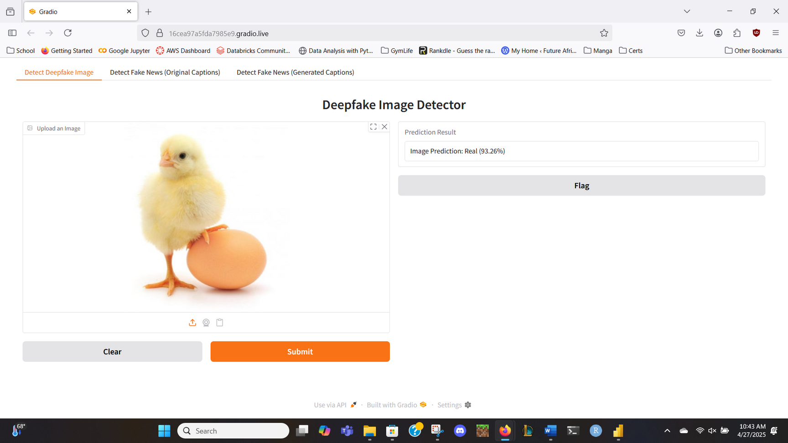
Image Model Test

Slide 20
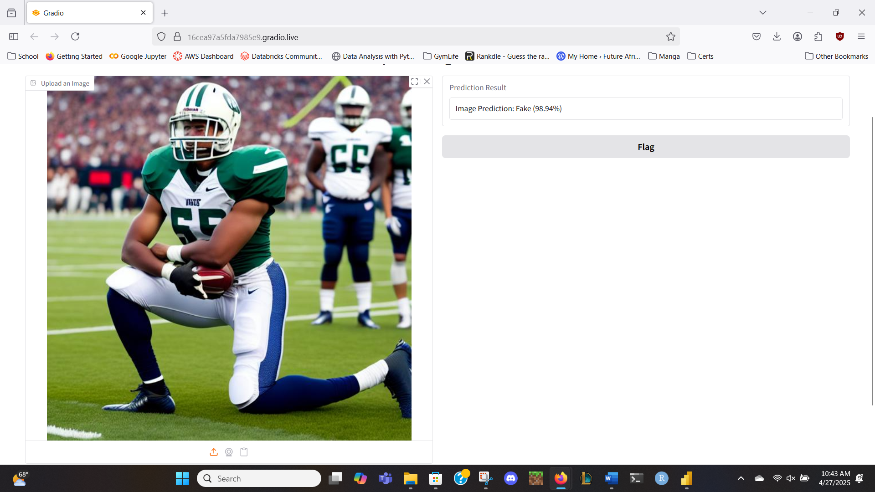
Image Model Test

Slide 21
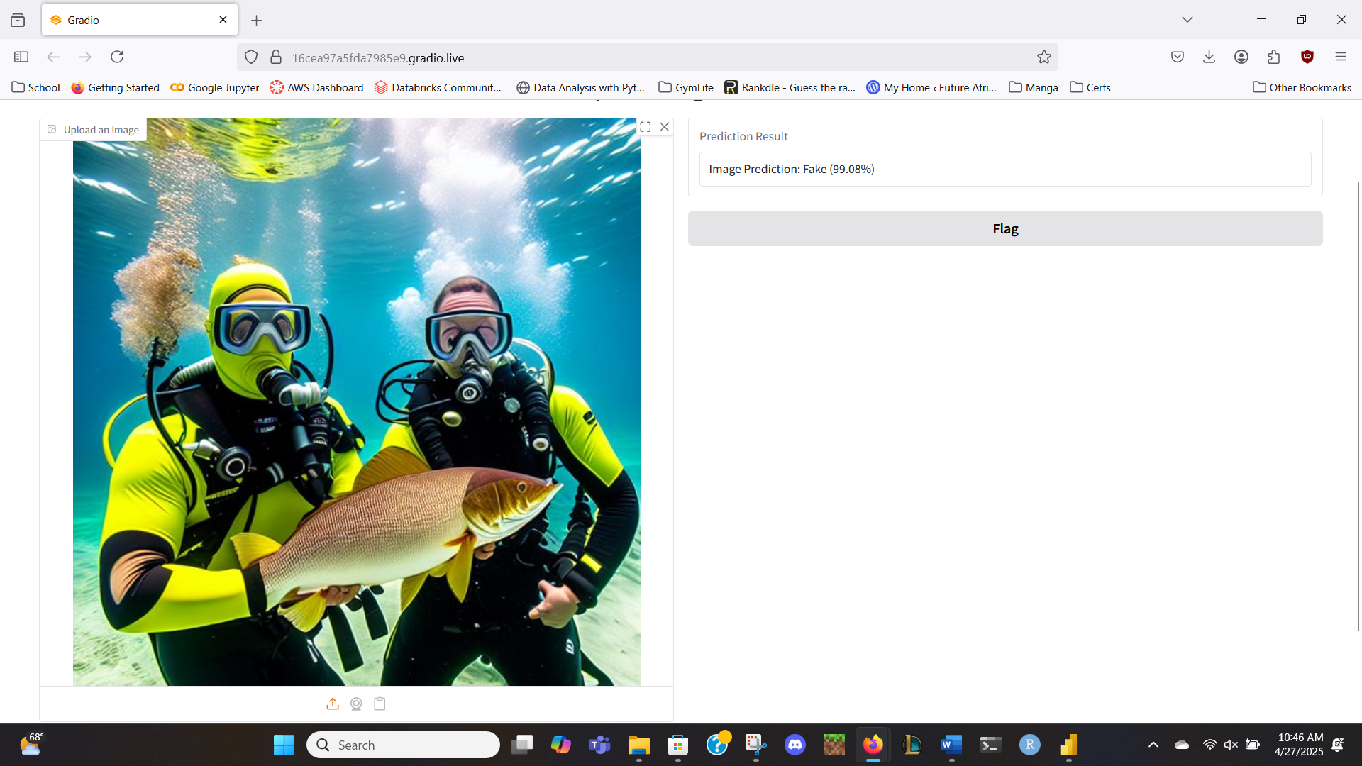
Image Model Test

Slide 22
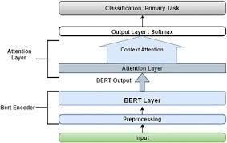
Text Model Overview
Model Architecture :
Fine-tuned BERT Base (bert-base-uncased) model.
Pretrained BERT provides strong language understanding for text classification.
Classification head added on top of BERT embeddings.
Model predicts whether a given news caption is Real News or Fake News
Hyperparameters & Training Setup:
Optimizer: AdamW optimizer (with weight decay).
Learning Rate: 2e-5 (0.00002).
Batch Size: 16.
Epochs: 4 (early stopping if validation loss plateaued).
Loss Function: Cross-Entropy Loss (for binary classification).
Tokenizer: bert-base-uncased tokenizer for input preprocessing.
Input: Tokenized text padded/truncated to 128 tokens maximum.

Slide 23
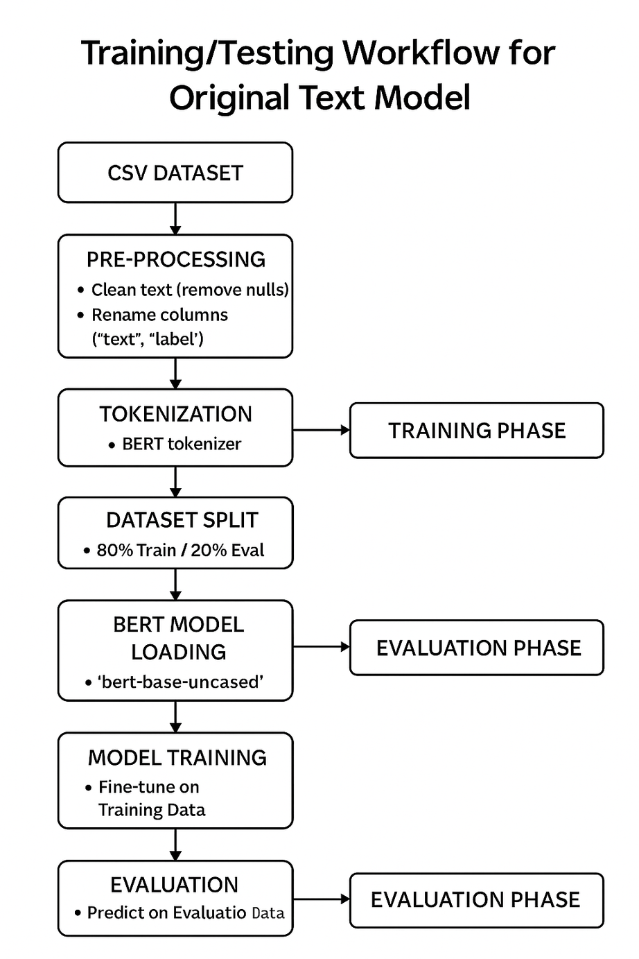

Slide 24

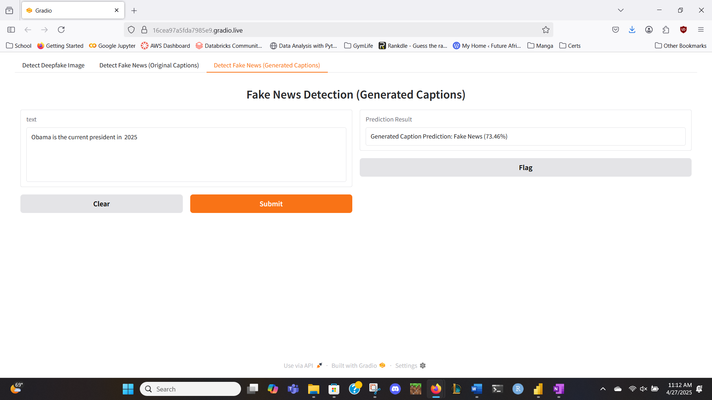
Success

Slide 25

Success

Slide 26
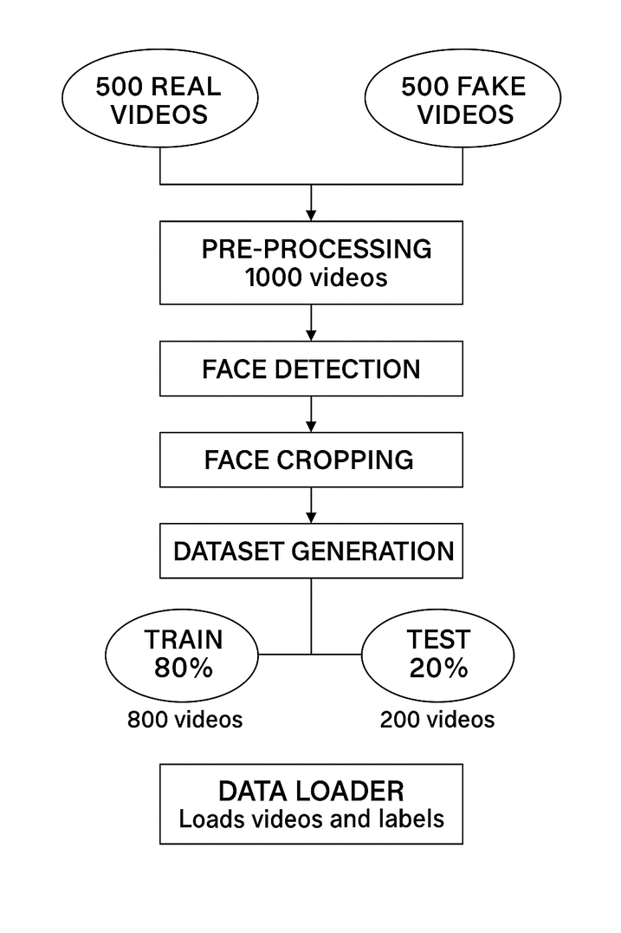
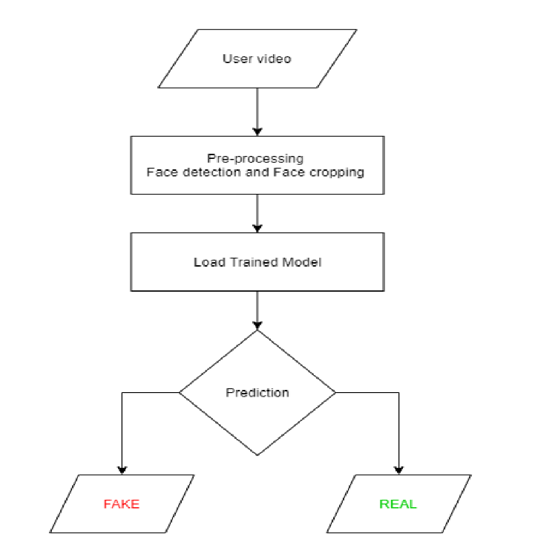
Training/ Testing Workflow for Video Model
To avoid Bias, and imbalance, we trained our Model using an equal number of fake & real videos.

Slide 27
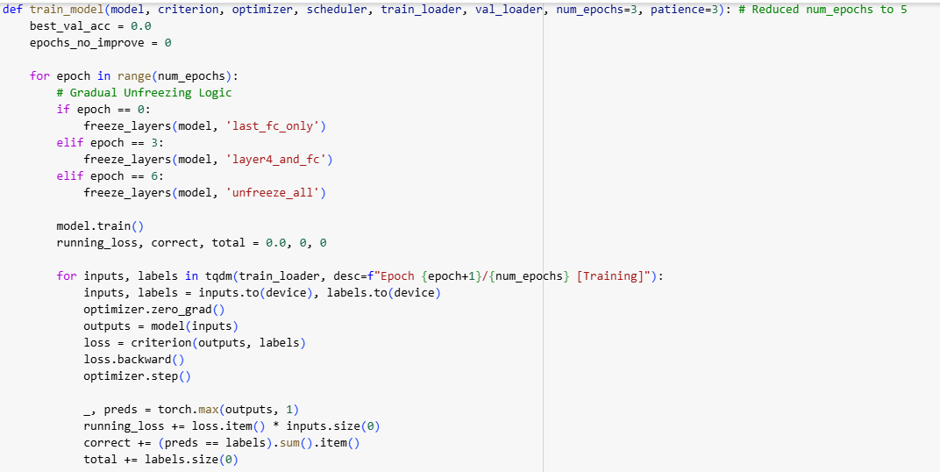

More About our Video Model
Model Architecture:
Used a Combination of CNN (ResNeXt) and RNN (LSTM).
ResNeXt CNN extracts frame-level features.
LSTM network uses these features to classify videos as deepfake or pristine.
Labels are loaded using Data Loader from the training split.
Model trained on extracted features from the sequential video frames.
Hyperparameters & Training Setup:
Optimizer: Adam optimizer with adaptive learning rate.
Learning rate: Tuned to 1e-5 (0.00001).
Weight decay: 1e-3 for better generalization.
Loss function: Cross-entropy (suitable for classification tasks).
Batch size: Set to 4, for experimental environment.
Batch training was used to optimize computational resource usage.
Used Epoch to help with model training & added Unfreezing

Slide 28
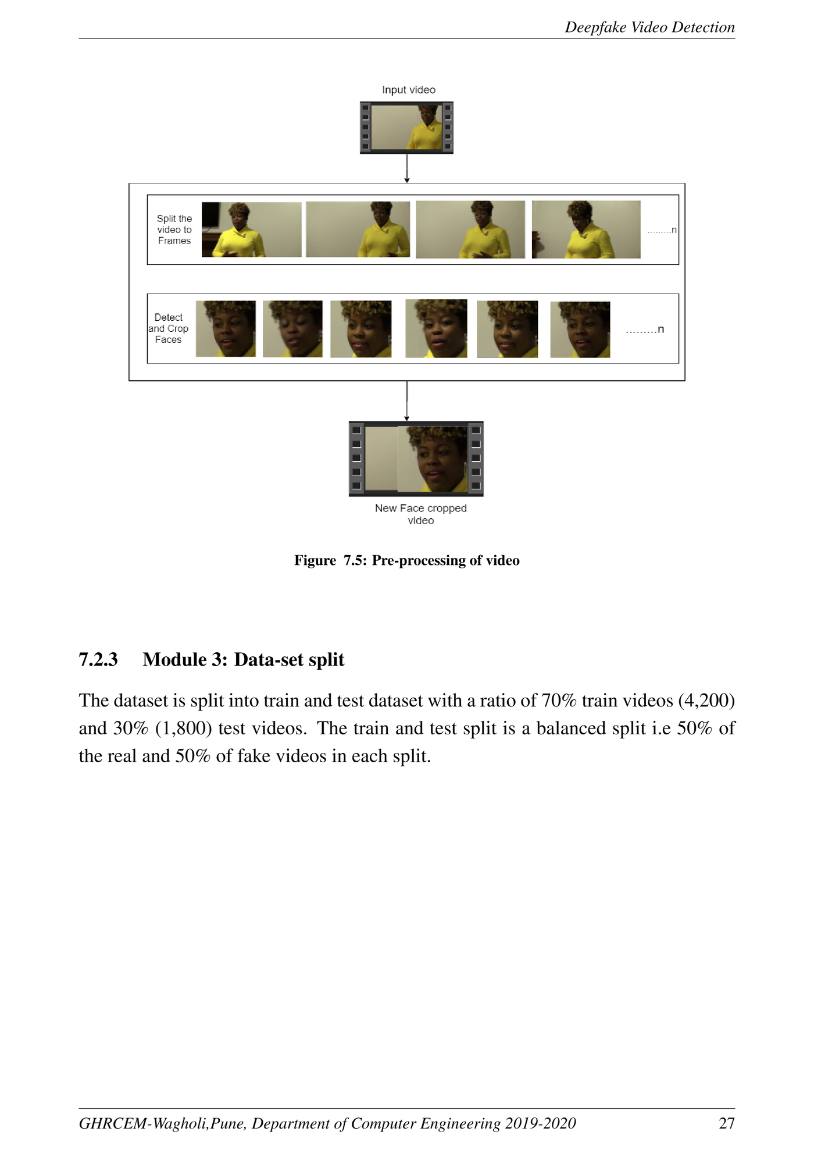
Video Time!
Preprocessing & Frame Extraction Summary:
Videos are split into frames.
Face detection is applied to each frame.
Only face-cropped frames are kept; non-face frames are discarded.
Frames are recombined to create videos that show only the face.
A threshold of 150 frames per video is chosen to maintain uniformity and reduce computation load.
The first 150 frames (in sequence) are selected, not random frames.
Video is saved at 30 frames per second and 112x112 resolution.
Designed to support LSTM-based sequential learning for better temporal modeling.

Slide 29
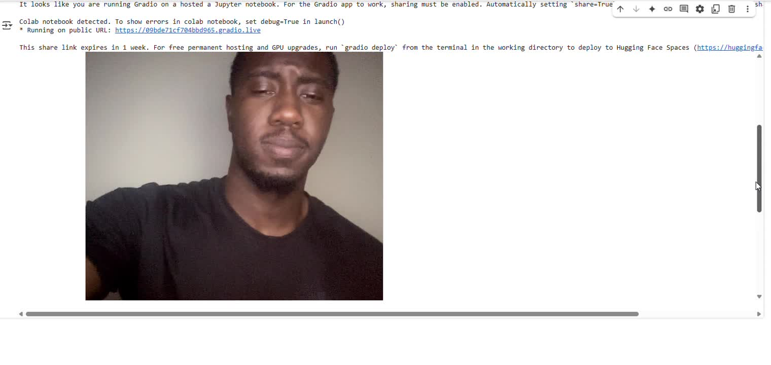
Success

Slide 30
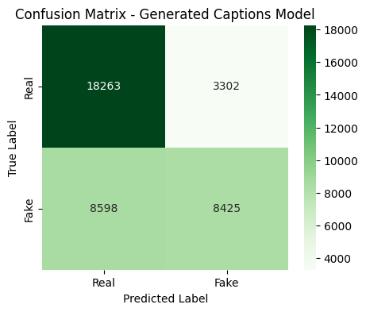
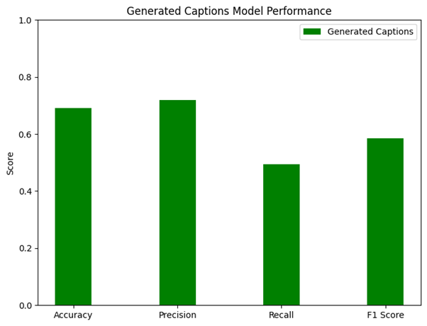
Visualizations

Slide 31
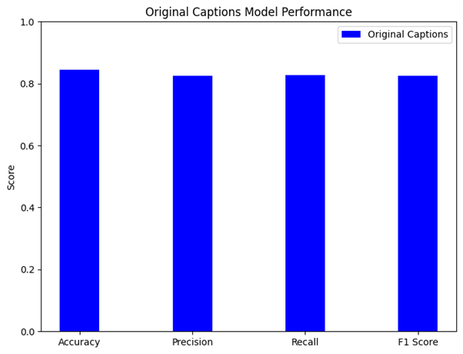
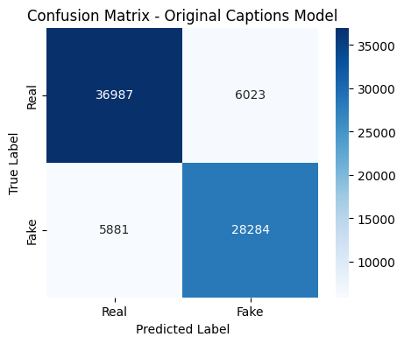
Visualizations

Slide 32
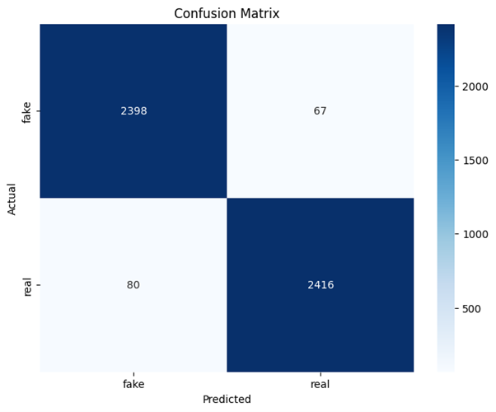
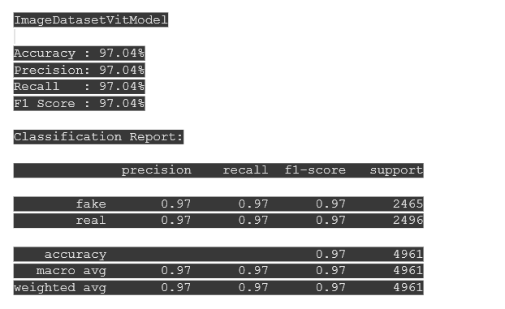
Visualizations

Slide 33
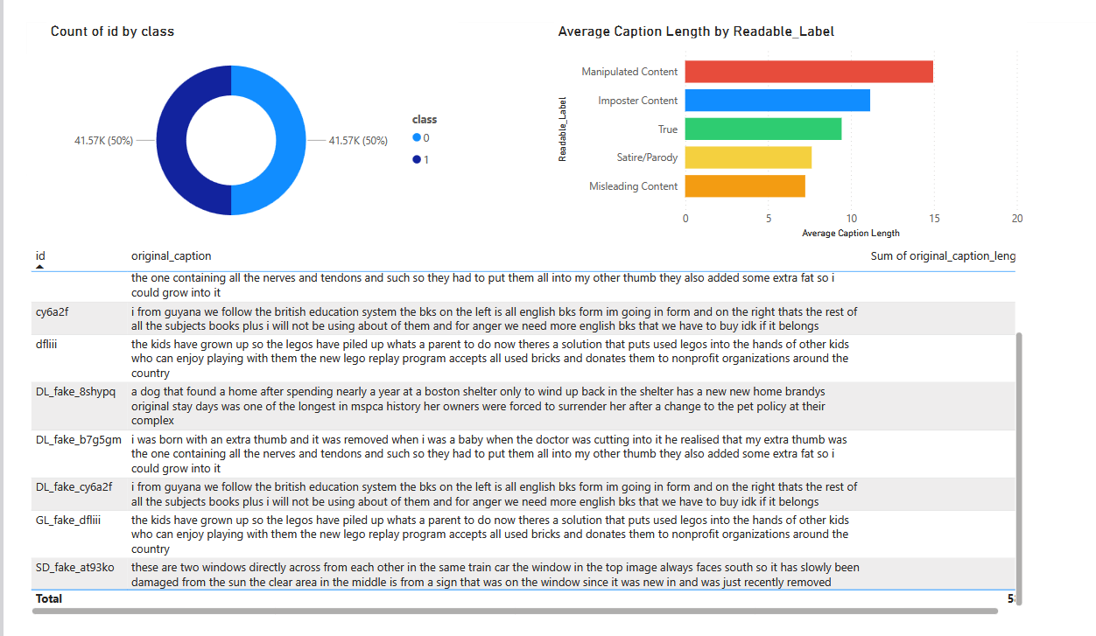
Power BI Dashboard/Report

Slide 34
Citations
Khalid, H., Khalifa, S., Ismail, F., & Eisa, T. A. (2019). Fake or Real? A Fast and Effective Deep Learning Approach for Fake News Detection [Preprint]. arXiv. https://arxiv.org/abs/1911.03854

